Slide 1
REVENUE ANALYSIS

Slide 2
Revenue and only Revenue Reveals the Competitive nature of the Market

Slide 3
Competitive nature of the Market
Perfect Competition
Imperfect Competition
Prices are uniform, since:
Prices are not uniform, since:
Large number of participants
Homogeneity of the units of the product
Free entry and exit of firms
Perfect knowledge among participants
Perfect mobility of factors
No transport cost
No government interference
One or more of the 7 conditions of Perfect Competition are not in operation here
Number of sellers are FINITE
One Seller (Monopoly)
Two Sellers (Duopoly)
Industry: the PRICE MAKER
Firms : PRICE TAKERS
Many Sellers (Monopolistic Comp.)
(20 – 100)
A Few Sellers (Oligopoly)
(3 to 20)
Price
Industry
Rev Cost
Firm
Rev, Cost
S
AC
Ei
P
MC
P
AR / MR
D
Qd, Qs
Qty
E
MR
AR
Qty

Slide 4
REVENUE SCHEDULE
Perfect Competition
Imperfect Competition
Qty | AR | TR | MR
1 | 2 | 2 | 2
2 | 2 | 4 | 2
3 | 2 | 6 | 2
4 | 2 | 8 | 2
5 | 2 | 10 | 2
6 | 2 | 12 | 2
7 | 2 | 14 | 2
Qty | AR | TR | MR
1 | 30 | 30 | 30
2 | 27 | 54 | 24
3 | 23 | 69 | 15
4 | 20 | 80 | 11
5 | 12 | 60 | - 20
6 | 6 | 36 | - 24
7 | 1 | 7 | - 29

Slide 5
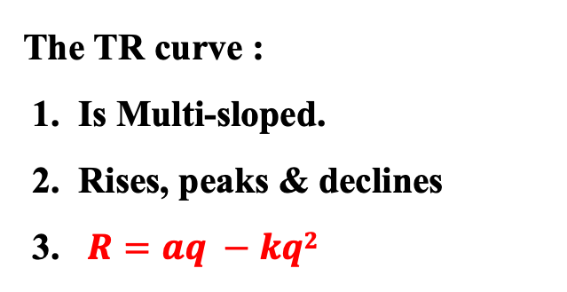
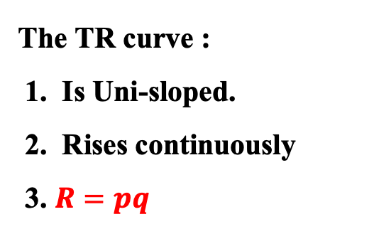
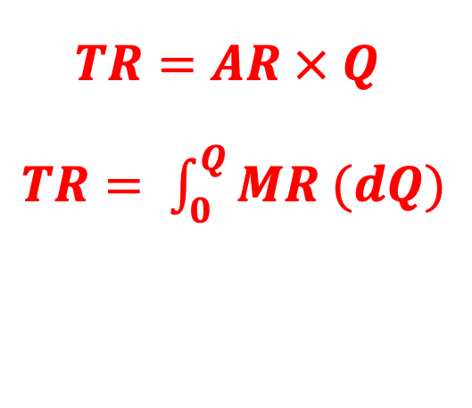
TOTAL REVENUE
TR refers to the overall sales receipts received at a given level of sales
Perfect Competition
Imperfect Competition
TR
TR
TR_{C}
$$TR=AR × Q$$
$TR= \int_{0}^{Q}{MR (dQ)}$
TR_{C}
Qty | TR
1 | 2
2 | 4
3 | 6
4 | 8
5 | 10
6 | 12
7 | 14
Qty
Qty
Qty | TR
1 | 30
2 | 54
3 | 69
4 | 80
5 | 60
6 | 36
7 | 07
The TR curve :
1. Is Uni-sloped.
2. Rises continuously
3. $R=pq$
The TR curve :
1. Is Multi-sloped.
2. Rises, peaks & declines
3. $R=aq −kq2$

Slide 6
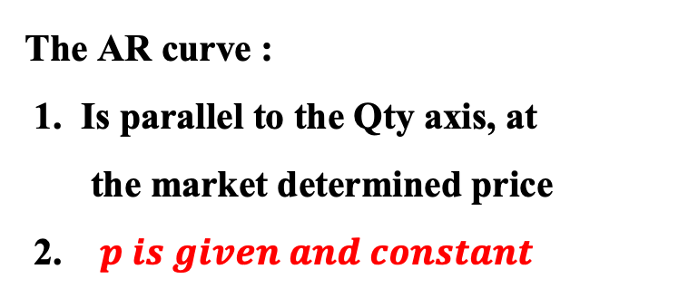
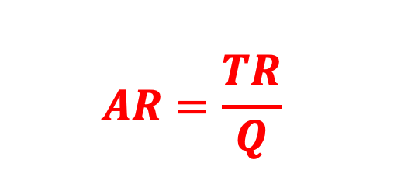
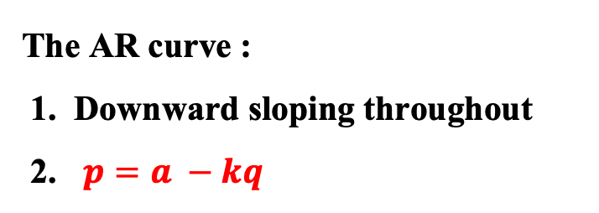
AVERAGE REVENUE
AR refers to sales receipts received per unit of sales
Perfect Competition
$$AR=\frac{TR}{Q}$$
AR
AR
Imperfect Competition
The AR curve is the demand curve
P
AR_{C}
AR is price
TR = (AR)(Q) & T. Exp. = (P)(Q)
TR = TE
hence (AR)(Q) = (P)(Q)
Thus, AR = P
AR_{C}
Qty
Qty
Qty | AR
1 | 30
2 | 27
3 | 23
4 | 20
5 | 12
6 | 6
7 | 1
Qty | AR
1 | 2
2 | 2
3 | 2
4 | 2
5 | 2
6 | 2
7 | 2
The AR curve :
1. Is parallel to the Qty axis, at
the market determined price
2. $p is given and constant$
The AR curve :
1. Downward sloping throughout
2. $p=a −kq$

Slide 7
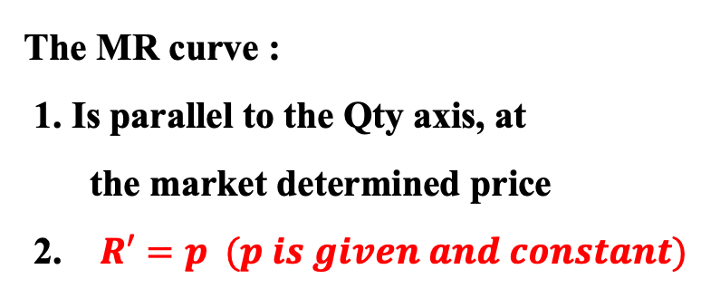
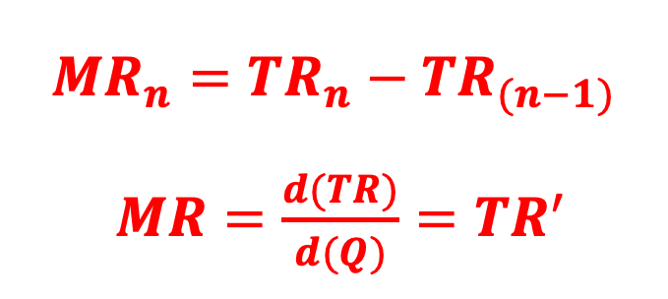
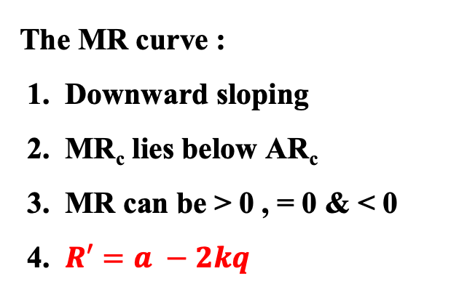
MARGINAL REVENUE
MR refers to additional sales receipts received by selling one more unit
MR
Perfect Competition
MR
Imperfect Competition
P
MR_{C}
$${MR}_{n}={TR}_{n}−{TR}_{(n−1)}$$
$MR=\frac{d(TR)}{d(Q)}={TR}^{′}$
AR_{C}
Qty
Qty
Qty | MR
1 | 2
2 | 2
3 | 2
4 | 2
5 | 2
6 | 2
7 | 2
Qty | MR
1 | 30
2 | 24
3 | 15
4 | 11
5 | - 20
6 | - 24
7 | - 29
MR_{C}
The MR curve :
1. Is parallel to the Qty axis, at
the market determined price
2. $R′=p (p is given and constant)$
The MR curve :
1. Downward sloping
2. MR_{c} lies below AR_{c}
3. MR can be > 0 , = 0 & < 0
4. $R′=a −2kq$

Slide 8
Revenue and only Revenue Reveals the Competitive nature of the Market
Perfect Competition
Imperfect Competition
Qty | AR | TR | MR
1 | 2 | 2 | 2
2 | 2 | 4 | 2
3 | 2 | 6 | 2
4 | 2 | 8 | 2
5 | 2 | 10 | 2
6 | 2 | 12 | 2
7 | 2 | 14 | 2
Qty | AR | TR | MR
1 | 30 | 30 | 30
2 | 27 | 54 | 24
3 | 23 | 69 | 15
4 | 20 | 80 | 11
5 | 12 | 60 | - 20
6 | 6 | 36 | - 24
7 | 1 | 7 | - 29

Slide 9
Revenue and only Revenue Reveals the Competitive nature of the Market
TOTAL REVENUE, AVERAGE REVENUE & MARGINAL REVENUE (all together)
Perfect Competition
Imperfect Competition
TR,
AR,
MR
TR_{C}
TR,
AR,
MR
TR_{C}
P
AR_{C} / MR_{C}
AR_{C}
Qty
Qty
MR_{C}

Slide 10
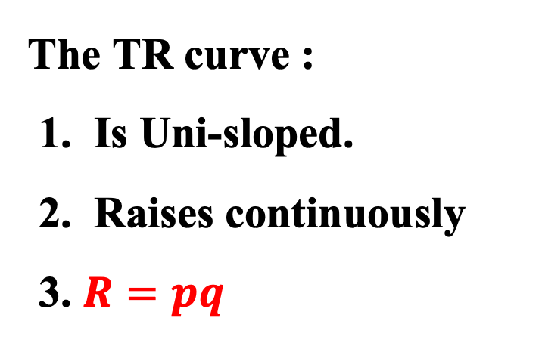
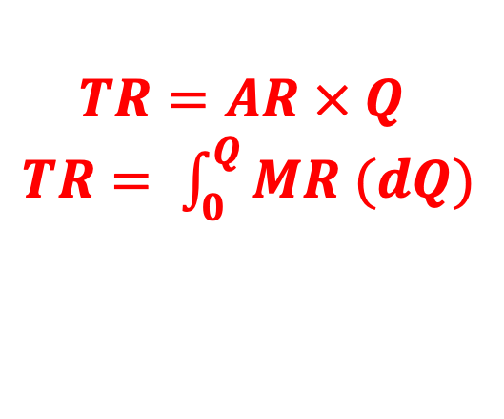
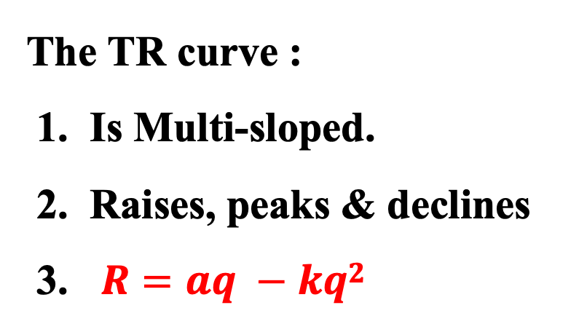
Revenue and only Revenue Reveals the Competitive nature of the Market
Perfect Competition
Imperfect Competition
TR,
AR,
MR
TR,
AR,
MR
TR_{C}
TR_{C}
P
AR_{C} / MR_{C}
AR_{C}
Qty
MR_{C}
Qty
TOTAL REVENUE
TR refers to the overall sales receipts received at a given level of sales
$$TR=AR × Q$$
$TR= \int_{0}^{Q}{MR (dQ)}$
The TR curve :
1. Is Uni-sloped.
2. Raises continuously
3. $R=pq$
The TR curve :
1. Is Multi-sloped.
2. Raises, peaks & declines
3. $R=aq −kq2$

Slide 11
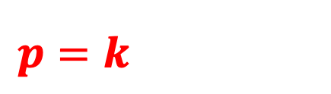
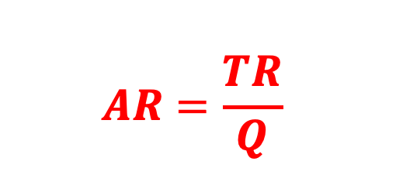
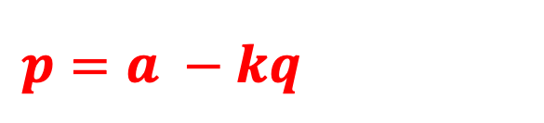
Revenue and only Revenue Reveals the Competitive nature of the Market
Perfect Competition
Imperfect Competition
TR,
AR,
MR
TR,
AR,
MR
TR_{C}
TR_{C}
P
AR_{C} / MR_{C}
AR_{C}
Qty
MR_{C}
Qty
AVERAGE REVENUE
AR refers to sales receipts received per unit of sales
$$AR=\frac{TR}{Q}$$
The AR curve is parallel to the Qty axis, at the market determined price
The AR curve is downward sloping throughout
$p=k$
$p=a −kq$
The AR curve is the demand curve
AR is price
Proof: TR = (AR)(Q) & T. Exp. = (P)(Q)
But TR = TE therefore (AR)(Q) = (P)(Q)
Thus, AR = P

Slide 12
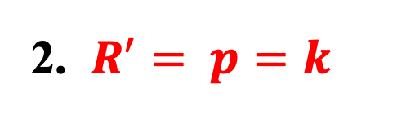



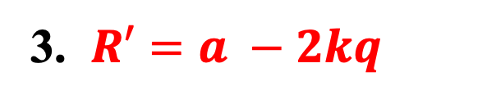
Revenue and only Revenue Reveals the Competitive nature of the Market
Perfect Competition
Imperfect Competition
TR,
AR,
MR
TR,
AR,
MR
TR_{C}
TR_{C}
P
AR_{C} / MR_{C}
AR_{C}
Qty
MR_{C}
Qty
MARGINAL REVENUE
MR refers to additional sales receipts received by selling one more unit
${MR}_{n}={TR}_{n}−{TR}_{(n−1)}$ OR $MR={TR}^{′ }= R^{′}=\frac{d(TR)}{d(Q)}$
1. The MR curve is parallel to the Qty axis, at the market determined price
1. The MR curve is downward sloping
2. V(MR) can be > 0 , = 0 & < 0
2. $R^{′}= p=k$
When $TR peaks, MR=0$
3. $R′=a −2kq$
$AR and MR curves are concurrent$ at the Market determined price
$$AR \& MR curves are divergent$$

Slide 13


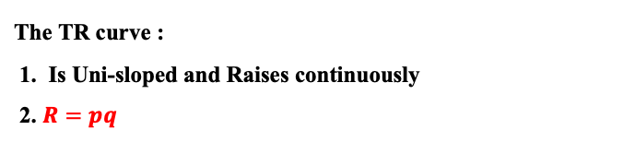

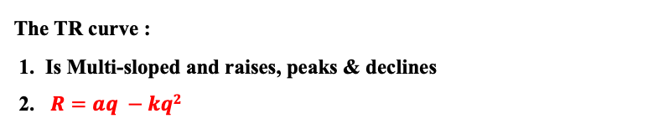



Perfect Competition
Imperfect Competition
Qty | AR | TR | MR
1 | 2 | 2 | 2
2 | 2 | 4 | 2
3 | 2 | 6 | 2
4 | 2 | 8 | 2
5 | 2 | 10 | 2
6 | 2 | 12 | 2
7 | 2 | 14 | 2
TR,
AR,
MR
Qty | AR | TR | MR
1 | 30 | 30 | 30
2 | 27 | 54 | 24
3 | 23 | 69 | 15
4 | 20 | 80 | 11
5 | 12 | 60 | - 20
6 | 6 | 36 | - 24
7 | 1 | 7 | - 29
TR,
AR,
MR
TR_{C}
TR_{C}
P
AR_{C} / MR_{C}
AR_{C}
Qty
Qty
MR_{C}
The TR curve :
1. Is Uni-sloped and Raises continuously
2. $R=pq$
The TR curve :
1. Is Multi-sloped and raises, peaks & declines
2. $R=aq −kq2$
The AR curve is parallel to the Qty axis, at the market determined price
The AR curve is downward sloping throughout
$p=k$
$p=a −kq$
1. The MR curve is parallel to the Qty axis, at the market determined price
1. The MR curve is downward sloping
2. $R^{′}= p=k$
2. $R′=a −2kq$
3. V(MR) can be > 0 , = 0 & < 0
When $TR peaks, MR=0$
$AR and MR curves are concurrent$ at the Market determined price
$$AR \& MR curves are divergent$$
$$Firm can opt for any of the objectives except Sales maximization$$
But it must accept the pricing strategy adopted by the Industry
$$Firm can opt for any of the objectives$$
$$and so can accordingly adopt the pricing stategy$$

Slide 14
Relationship between AR and MR
(Proof of 50 – 50, via Geometry)
Statement:
The MR curve bisects the horizontal perpendicular drawn from the AR curve to the vertical axis, if the AR and MR are linear functions.

Slide 15
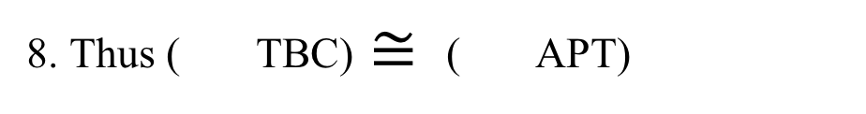
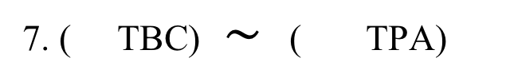
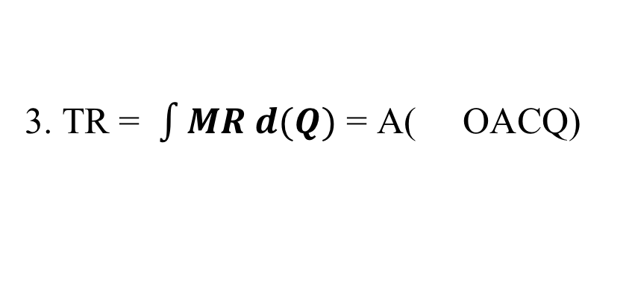

AR - MR relationship (given, AR and MR are Linear Functions)
AR, MR
1. TR = (AR)(Q) = A( OPBQ)
A
Let the Price = OP and the corresponding Qty = OQ
2. TR = A( OPTCQ) + A( TBC)
B
P
T
3. TR = $\int{MR d(Q)}$ = A( OACQ)
C
4. TR = A( OPTCQ) + A( APT)
5. A( OPTCQ) + A( TBC)
= A( OPTCQ) + A( APT)
ARc
from 2 and 4
MRc
6. A( TBC) = A( APT)
Q
D
from 5
Qty
7. ( TBC) $∼$ ( TPA)
AA test
8. Thus ( TBC) $≅$( APT)
from 6 & 7, if similar triangles have equal areas, the triangles are congruent.
9. Thus, PT $≅$ TB csct from 8
Thus, the MR curve bisects the horizontal perpendicular between the AR curve and the vertical axis

Slide 16
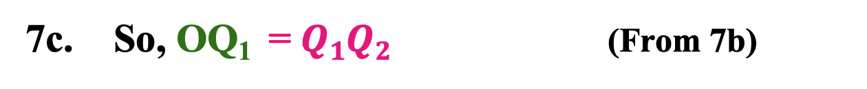
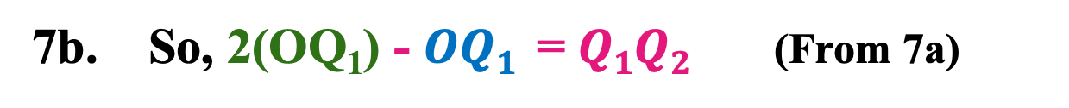
Linear AR - MR Relationship (Proof of 50 – 50, via Functions )
$0. TR=aq −pq2; AR=a −pq$; $MR=a −2pq$
AR, MR
A
1. At Price OP, MR = AR; TQ₁ = BQ₂ = OP
2. At Price OP, qty signified by MR is OQ₁
T
B
P
3. At Price OP, qty signified by AR is OQ₂
4. MR: R’ = a – 2(OP)(OQ₁) (From 0, 1, 2)
5. AR: p = a – (OP)(OQ₂) (From 0, 1, 3)
6. At Price OP, from steps 1, 4 & 5 it follows that:
a – 2(OP)(OQ₁) = a – (OP)(OQ₂)
ARc
MRc
7. Hence, 2(OQ₁) = (OQ₂) (From 6)
Q₁
Q₂
D
Qty
7a. So, 2(OQ₁) = $OQ1+Q1Q2$ (From 7, O - Q₁- Q₂)
7b. So, 2(OQ₁) - $OQ1$ =$Q1Q2$ (From 7a)
7c. So, OQ₁ =$Q1Q2$ (From 7b)
8. PT = TB From 7c, Rectangular Property
Thus, the MR curve bisects the horizontal perpendicular drawn between the AR curve and the vertical axis

Slide 17
Relationship b/w Non-Linear AR - MR
If the AR & MR curves are CONCAVE
If the AR & MR curves are CONVEX
AR, MR
AR, MR
A
A
P
D
B
B
P
T
D
T
ARc
ARc
MRc
MRc
Qty
Qty
MR intersects the horizontal perpendicular at MORE than the mid-point
MR intersects the horizontal perpendicular at LESS than the mid-point

Slide 18
Non-Linear AR - MR
Linear AR - MR
CONCAVE
CONVEX
AR, MR
AR, MR
AR, MR
A
A
D
P
B
T
P
B
D
ARc
P
B
T
T
ARc
ARc
MRc
MRc
MRc
Qty
D
Qty
Qty
More than the mid-point
Less than the mid-point
At the mid-point
TR’ is b/w 0 & 2 of AR’
TR’ is 2+ times of AR’
TR’ is exactly 2 times of AR’

Slide 19
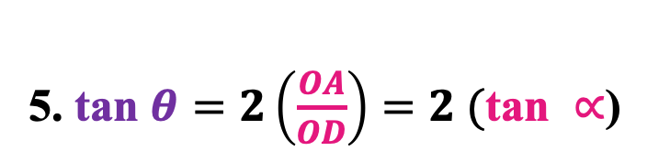

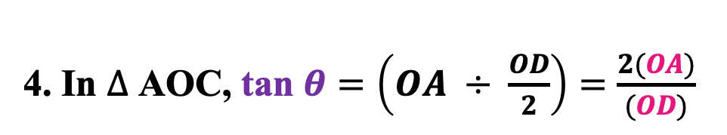

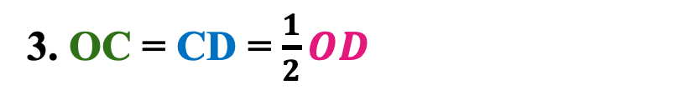
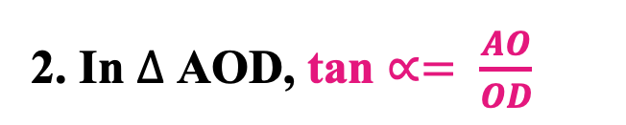
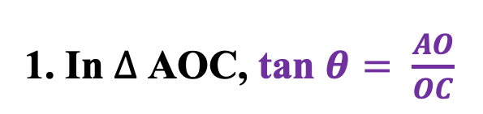
Consequence of AR - MR relationship (Given AR and MR are linear functions)
AR, MR
A
1. In $∆$ AOC, tan $θ= \frac{AO}{OC}$
2. In $∆$ AOD, tan $∝= \frac{AO}{OD}$
3. OC = CD = $\frac{1}{2}OD$
4. In $∆$ AOC, tan $θ=\left(OA ÷ \frac{OD}{2}\right)=\frac{2(OA)}{(OD)}$
ARc
MRc
5. tan $θ=2\left(\frac{OA}{OD}\right)=2 (\text{tan} ∝$)
$$θ$$
$$∝$$
C
D
Qty
6. ∴ slope of MR = 2(slope of AR)
7. ∴ This shows that the TR changes at twice rate of change in Price
8. ∴ Hence, an increase in Price, would mean that the TR increases at twice that rate
9. ∴ Hence, a decrease in Price, would mean that the TR decreases at twice that rate

Slide 20
Relationship b/w Non-Linear AR - MR
If the AR & MR curves are CONCAVE,
slope of MR_{c} > slope of AR_{c}
If the AR & MR curves are CONVEX,
slope of MR_{c} > slope of AR_{c}
AR, MR
AR, MR
A
A
M
ARc
M
ARc
MRc
MRc
Q
Qty
Q
Qty

Slide 21
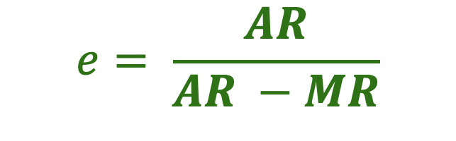
The Relationship between
AR, MR & e_{dp}
Via Calculus
$$e= \frac{AR}{AR −MR}$$

Slide 22
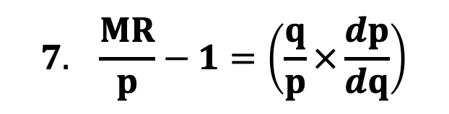
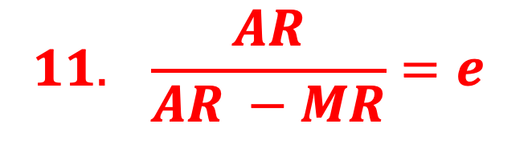
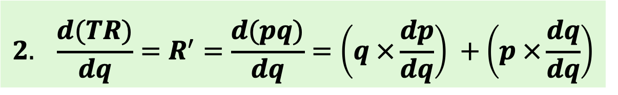
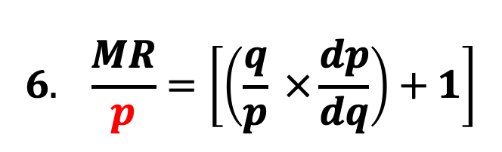

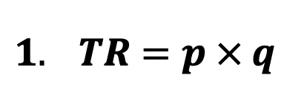

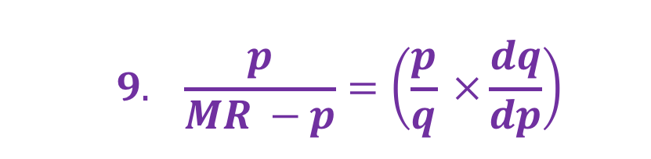
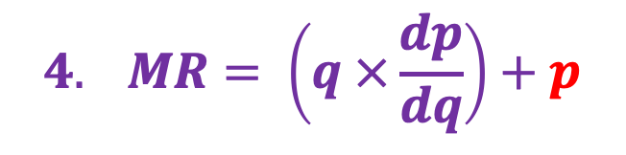

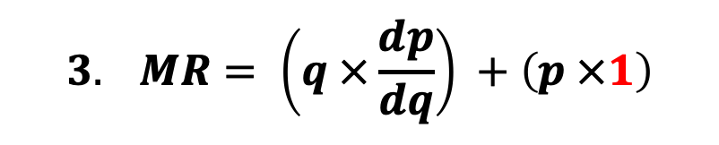
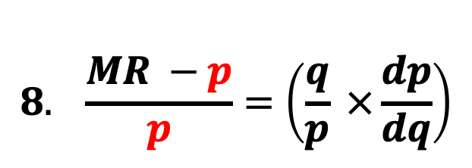
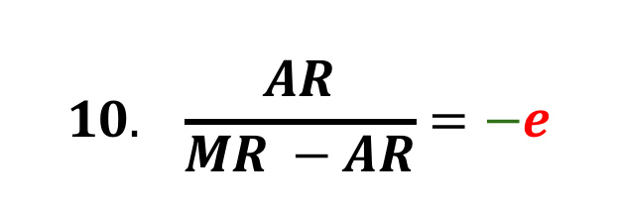
$$2. \frac{d(TR)}{dq}=R^{′}=\frac{d(pq)}{dq}=\left(q ×\frac{dp}{dq}\right) +\left(p ×\frac{dq}{dq}\right)$$
$1. TR=p × q$
$$3. MR= \left(q ×\frac{dp}{dq}\right) +\left(p ×1\right)$$
$$4. MR= \left(q ×\frac{dp}{dq}\right)+p$$
$$6. \frac{MR}{p}=\left[\left(\frac{q}{p} ×\frac{dp}{dq}\right)+1\right]$$
$$5. MR=p\left[\left(\frac{q}{p} ×\frac{dp}{dq}\right)+1\right]$$
$$8. \frac{MR −p}{p}=\left(\frac{q}{p} ×\frac{dp}{dq}\right)$$
$$7. \frac{MR}{p}−1=\left(\frac{q}{p}×\frac{dp}{dq}\right)$$
$$9. \frac{p}{MR −p}=\left(\frac{p}{q} ×\frac{dq}{dp}\right)$$
$$Using invertendo$$
$$10. \frac{AR}{MR −AR}=−e$$
$$In keeping with the Law of Demand$$
$$for Normal Goods$$
$$11. \frac{AR}{AR −MR}=e$$

Slide 23



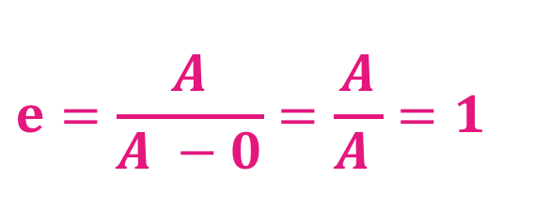
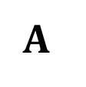


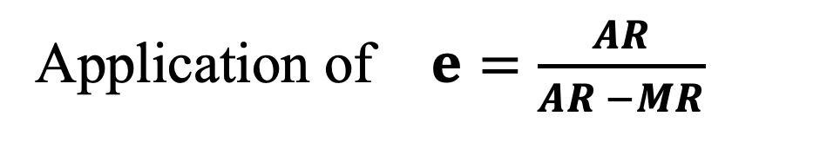


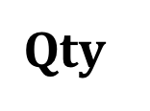
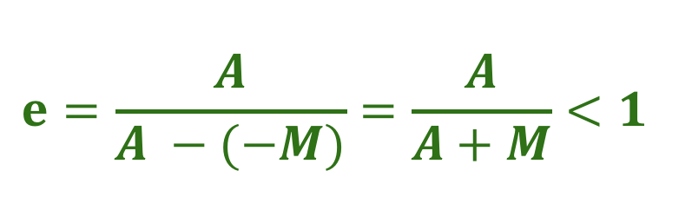

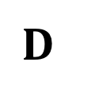

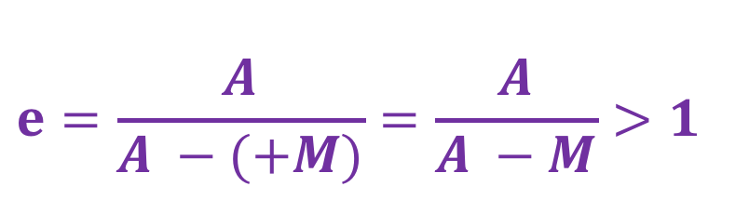

Application of $e=\frac{AR}{AR −MR}$
$$=\frac{MD}{MA}$$
$$e_{dP}=\frac{Lower Segment}{Upper Segment}$$
$$AR,$$
$$MR$$
$$e>1; RE$$
= mid-pt. of AD; $e=1; UE$
$$A$$
If MR > 0
$$e=\frac{A}{A −(+M)}=\frac{A}{A −M}>1$$
$$e<1; RIE$$
$$M$$
If MR = 0
$$e=\frac{A}{A −0}=\frac{A}{A }=1$$
$$ARc$$
$$T$$
$$D$$
$$Qty$$
$$e=\frac{A}{A −(−M)}=\frac{A}{A+M}<1$$
If MR < 0
$$MRc$$

Slide 24












$$1 e=\frac{A}{A −M}$$
i$. e=\frac{A}{A −M}$
ii$. e\left(A −M\right)=A$
2 $e\left(A −M\right)=A$
$$iii. eA −eM=A$$
$$3 eA −eM=A$$
$$iv. −eM =A −eA$$
$$4 eA −A =eM$$
$v. eM =eA$ - A
$$5 A (e −1) =eM$$
$$vi. . M=\frac{A(e −1)}{e }$$
6$A=\frac{eM}{(e −1) }$

Slide 25
BANDWAGON EFFECT
Individual A
Individual B
Market
Price
Price
Price
P₁
E_{A1}
E_{B1}
T_{M1}
E_{A2}
E_{B2}
T_{M2}
P₂
D_{B1}
D_{BW}
D_{A1}
D_{B2}
D_{A2}
D_{M2}
D_{M1}
Qty
Qty
Qty (100)
The Price of the concerned good falls
The Demand for the concerned good rises ( Demand curves shift upwards to the right)
By joining T_{M1} and T_{M2} we obtain the gently sloped Bandwagon Effect demand curve D_{BW}

Slide 26
SNOB GOOD EFFECT
Individual A
Individual B
Market
Price
Price
Price
D_{B1}
D_{B2}
E_{A1}
P₁
E_{B1}
T_{M1}
E_{B2}
T_{M2}
P₂
E_{A2}
D_{SG}
D_{A1}
D_{M2}
D_{A2}
D_{M1}
Qty
Qty
Qty (100)
The Price of the concerned good falls
The Demand for the concerned good fell by individuals A (elite) (DDc shifted downwards)
But the Demand for the concerned good rose by individuals B (non-elite) (DDc shifted upwards
By joining T_{M1} and T_{M2} we obtain the steeply sloped Snob Good demand curve D_{SG}

Slide 27
Perfect Competition
Imperfect Competition
Rev,
Cost
MC
Rev, Cost
AC
MC
AC
E
P
R
P
AR / MR
T
C
T
C
E
AR
MR
Q2
Qty
Q2
Qty
 | Perfect Comp | Imperfect Comp
TR | R = bq (Linear Curve) | R = aq – bq² (Non-Linear Curve)
MR | R’ = p (curve || X-axis at pt p) | R’ = a – 2bq (downward sloping curve)
AR | p = K (curve || X-axis at pt p and so prices are uniform) | p = a – bq (downward sloping curve and so prices are not uniform)
AR & MR Rel | Concurrent curves | Divergent curves (AR above MR)
AR & MR Rel | AR = MR = p | AR & MR curves differ
Sales Max | Not compatible | Possible
Profit Max | Possible | Possible
B.E. Firm | Possible | Possible
Price Ed | perfectly Elastic | non-perfectly Elastic

Slide 28



$AR= 20$ & Edp = 2, MR = ?
$$e=\frac{AR}{AR −MR}=$$
$$2=\frac{20}{20 −MR}$$
40 – 2MR = 20;
2MR = - 20
MR = 10 (MR is Positive)

Slide 29



$$AR Function: P=36 −2q$$
$TR Function:TR=$ P * Q R = 36q - 2q²
$MR curve:$ TR’ = 36 – 4q
$MR curve:$ 0 = 36 – 4q qty = 9
$V\left(TR@ q=9\right)$ R = 36*9 - 2*9² = 162

Slide 30



$$AR Function: P=500 −0.25q$$
$$TC Function: C=q^{3}−q^{2}+25q+100$$
$$TR Function: R=500q −0.25q^2$$
$Profit =500q −0.25q^{2} −(q^{2}+25q+100$)
$Profit =500q −0.25q^{2} −q^{2}−25q − 100$)
$$Profit =π =−1.25q^{2}+475q − 100$$
$${\left(π\right)}^{′} =−2. 5q^{2}+475=0, ∴ q=sqrt 190=14$$
${V\left(π\right)}^{max} =−1.25q^{2}+475q − 100$ $=−1.25{(14)}^{2}+475\left(14\right)− 100=6405$
$${V\left(π\right)}^{max} the price should be Rs 497$$

Slide 31






$$AR Function: P=32 −3q$$
$$TC Function: C=q^{2}+8q+5$$
$$TR Function: R=32q −3q^2$$
$$AC Function: c=q+8+5/q$$
M$R Function: R′=32 −6q$
M$C Function:C =2q+8$
$$pie Function: pie=32q −3q^{2}−q^{2}−8q − 5= −4q^{2}+24q −5$$
$$pie max: = −8q^{}+24=0 thus, Q=3$$
$V(pie max): =−4{\left(3\right)}^{2}+24(3) −5$ = -36 + 72 – 5 = 31
$V\left(Sales max\right): =2q+8=$0 q = 4 units pie = Rs 27 price = 20
$V\left(Break−even\right):32q −3q^2=q^{2}+8q+5$ - 4q^2 + 24q – 5 = 0

Slide 32








$$AR Function: P=32 −3q$$
$$TC Function: C=q^{2}+8q+5$$
$$TR Function: R=32q −3q^2$$
$AC Function: c=q+8+5$/ q
$$MR Function: R′=32 −6q$$
$$MC Function: C′=2q+8$$
Pie $Function: 32q −3q^2$ - $q^{2}−8q−5$
Pie $Function: −4q^2$ +$24q−5$
$−4q^2$ +$24q−5$ = 0 q1 = 5.78 units and q2 = 0.22 units
$$AR Function: P2=32 −3\left(5.78\right)=14.66 P2=32 −3\left(0.22\right)=31.34$$

Slide 33




$$AR Function: P=32 −3q$$
$$TC Function: C=q^{2}+8q+5$$
$$TR Function:R=32q −3q^2$$
$AC Function: c=q+8+5$/ q
$$MR Function: R′=32 −6q$$
$$MC Function: C′=2q+8$$
Pie $Function: −4q^2$ +$24q−5$
Pie’$= −8q$ +$24=0 so q= 3 units$
$−4(3)^2$ +$24\left(3\right)−5 =Rs 31$
$$P=32 −3\left(3\right)= Rs 23$$
$$R@ q=3 is 32\left(3\right)−3{\left(3\right)}^{2}= Rs 69$$
$$TC@ q=3 is Rs 38$$
$32 −6q$ = $2q+8$ q = 3

Slide 34





$$AR Function: P=500 −0.25q$$
$P=452.5$ R’ = 405 452.5/(452.5-405)
= 8.62 = RE
$$TR Function: R=500q −0.25q^2$$
$$MR Function: R^{′}=500 −0.5q$$
$$TC Function C=q^{2}+25q+100$$
$$AC Function C=\frac{TC}{q}=q+25+\frac{100}{q}$$
$$MC Function= C′=2q+25$$
$$Profit Function: 500q −0.25q^{2}−q^{2}−25q−100$$
$$Profit Function: −1.25q^{2}+475q−100$$
$$PF^{′}=0= −2.5q+475 q=190$$
$$Value Max Profit= −1.25{\left(190\right)}^{2}+475\left(190\right)−100=Rs + 45025$$

Slide 35





$$TR Function: R=30q −q^2$$
$$AR Function: P=30 −q$$
$P=29$ R’ = 28 29/(29-28) = 29 = RE
$$MR Function: R^{′}=30 −2q$$
$$TC Function C={20q+ 4q}^{2}$$
$$AC Function C=\frac{TC}{q}=20+4q$$
$$MC Function= C′=20+8q$$
$$Profit Function: 30q −q^{2}−{4q}^{2}−20q$$
$$Profit Function: −5q^{2}+10q$$
$$PF^{′}=0= −10q+10 q=1$$
$$Value Max Profit= −5{\left(1\right)}^{2}+10\left(1\right)=Rs+ 5$$
$$AR Function: P=30 −q=29$$

Slide 36

MPP 1 Microeconomics Test 4 13/9/25, 30 marks 40 minutes
1. If $\overline{X}=25$ and $\overline{Y}=10$ also $\sum{x^{2}=92 }$and $\sum{xy=37 }$, find the vertical intercept of this regression equation (2)
2. From the demand equation d = 82000 – 0.3Y, find the value and degree of the income elasticity of demand at income (Y) = Rs 25000 (2)
3. Draw an aptly labelled graph depicting the Law of Variable proportions (5)
4. List 6 innovations that have taken place in the writing material industry. How have these innovations deepened the market for these products? (6)
5. Through a revenue schedule and an apt graphical depiction, show the differences in the revenue functions of firms operating under Per Comp and Imperfect Comp (10)
6. Explain the concept of the Expansionary Path (EP) (with lab on the horizontal axis and cap on the vertical axis). Show how public policy changes have changed the slopedness of the EP due since the industrial revolution for the textile industry (5)

Slide 37

MPP 1 Microeconomics Test 4 13/9/25
1. If $\overline{X}=25$ and $\overline{Y}=10$ also $\sum{x^{2}=92 }$and $\sum{xy=37 }$, find the vertical intercept of this regression equation (2 marks)
h = 10 – 25(37/92) = - 0.054
2. From the demand equation d = 82000 – 0.3Y, find the value and degree of the income elasticity of demand at income (Y) = Rs 25000 (2 marks)
d = 82000 + 0.3*(25000) = 89500, hence income elasticity of demand =
at income (Y) = Rs 25000 is (0.3)* (25000/89500) = 0.084 Degree: RIE
3. Draw an aptly labelled graph depicting the Law of Variable proportions (5 marks)
4. List 6 innovations that have taken place in the writing material industry. How have these innovations deepened the market for these products? (6)
5. Through a revenue schedule and an apt graphical depiction, show the differences in the revenue functions of firms operating under Per Comp and Imperfect Comp (10)

